Slide 1
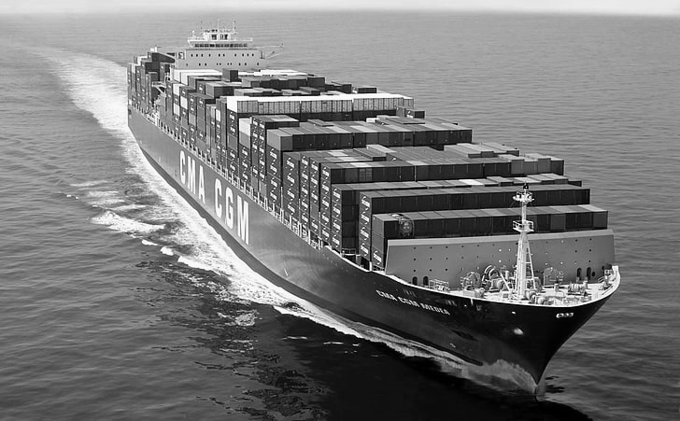
Satellite Ship Classification
Adi Daniel Tzuf Lahan Ayelet- Hashahar Cohen

Slide 2

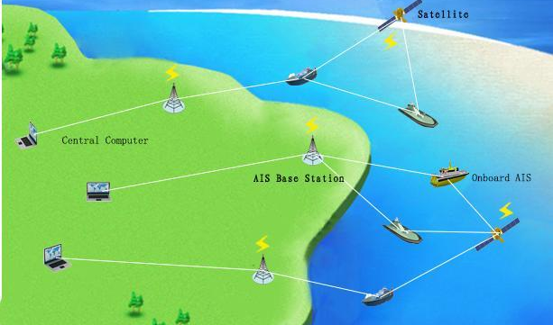
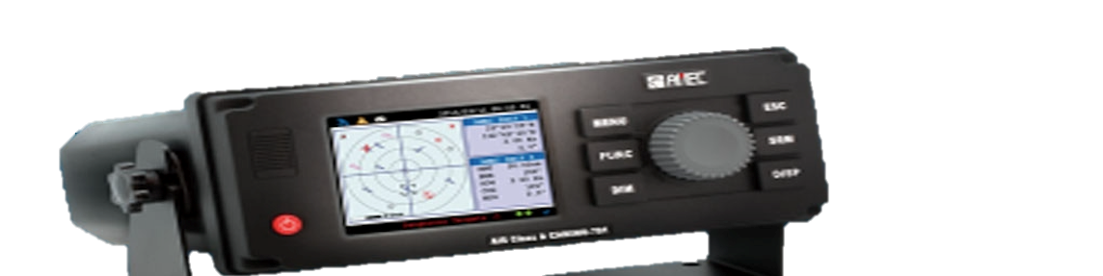
What is AIS ?
Automatic Identification System

Slide 3
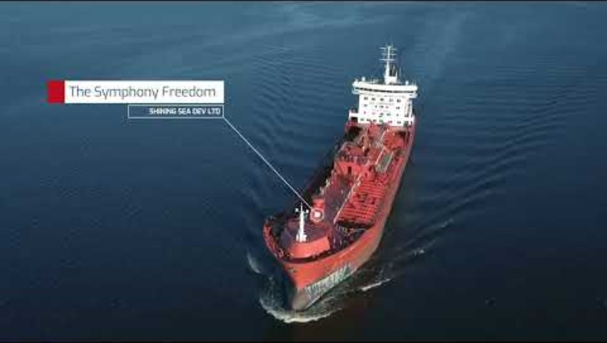

Slide 4
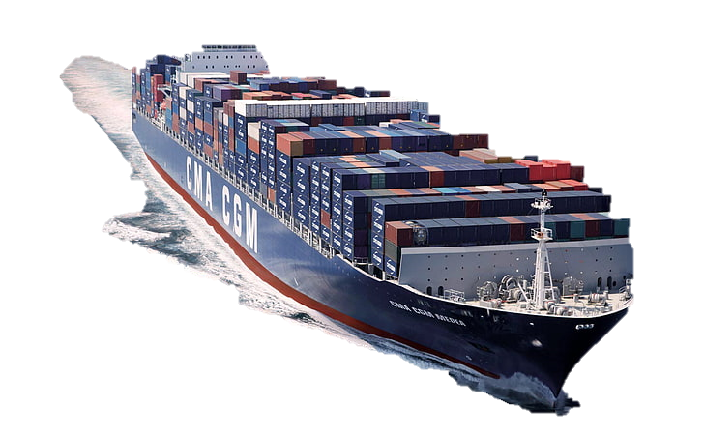
Background & Motivation
Satellite imagery is key for maritime monitoring, including traffic, illegal fishing, and naval security.
Ship classification is challenging due to subtle differences in imagery, varying resolutions, and complex visual noise.
Manual analysis is slow and doesn’t scale for large, long-term surveillance.
Satellite
Classification
Alert

Slide 5
Problem Definition
The goal is to develop an automated method to detect and classify ships in satellite images.
Challenges include:
Distinguishing ships from similar-looking objects (e.g., waves, ports, clouds).
Dealing with variations in ship size, shape, angle, and image quality.
Handling imbalanced datasets.
Creating a reliable model that works well across different environments.

Slide 6

Model Applications
Maritime Surveillance:
Find out if there are ships in satellite images — helps with defense and border patrol.
Port & Traffic Monitoring:
Check if ships are near ports to track sea traffic and spot congestion.
Illegal Fishing Detection:
Detect fishing in forbidden areas by identifying ships in protected zones.
Environmental Monitoring:
Spot ships in sensitive areas (like oil spills) to monitor environmental risks.
Supply Chain Visibility:
See where cargo ships are to help track global shipping and deliveries.

Slide 7

Model Limitations
Small or distant ships are harder to classify
Environmental variability
Limited dataset diversity
Background noise causes false positives

Slide 8

What Makes Our Project Unique
We improved ship classification beyond just using existing models like Faster R-CNN, focusing on better accuracy and real-world use:
Focused on Real-Time Suitability – We tested models that can work in real-time settings.
Compared two modeling approaches – YOLOv8 and ResNet50 - on both regular and enhanced images.
Used Super-Resolution (SwinIR) – To enhance image quality and detect smaller or distant ships more effectively.

Slide 9








Our Workflow Pipeline
Original data
YOLO V8 Fine-tuning
EDA
Enhanced Satellite resolution
YOLO8 and ResNet 50 Fine-tuning
Evalutaion
Original data
ResNet50 Model training

Slide 10
Exploratory Data Analysis (EDA)

Slide 11
YOLOv8-Nano Classification Model

Slide 12
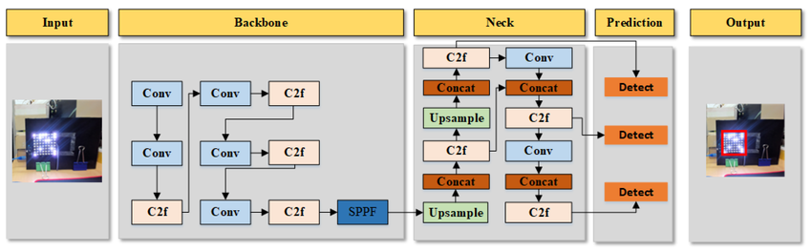
YOLOv8-Nano Classification Model

Slide 13
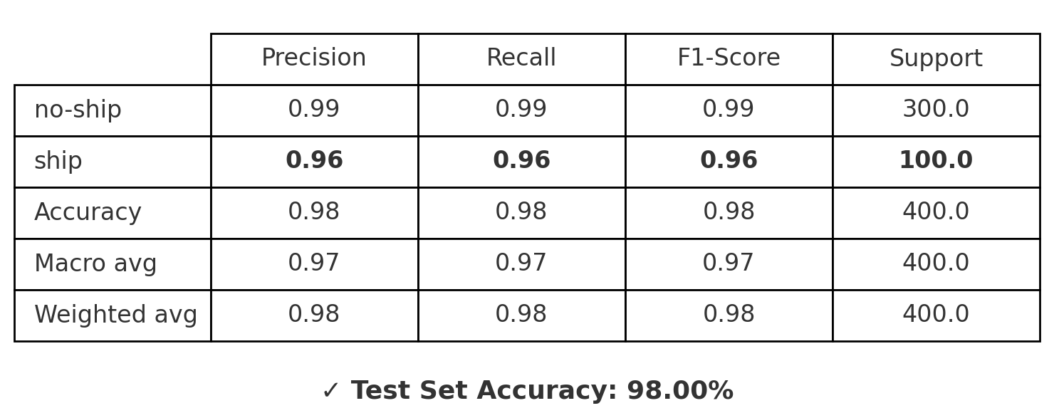
Classification Report – Test set
 | Precision | Recall | F1-Score | Support
Ship | 1.00 | 0.97 | 0.99 | 300
No-ship | 0.93 | 1.00 | 0.96 | 100
Accuracy | 0.98 | 0.98 | 0.98 | 400
Marco avg | 0.96 | 0.99 | 0.97 | 400
Weighted avg | 0.98 | 0.98 | 0.98 | 400

Slide 14
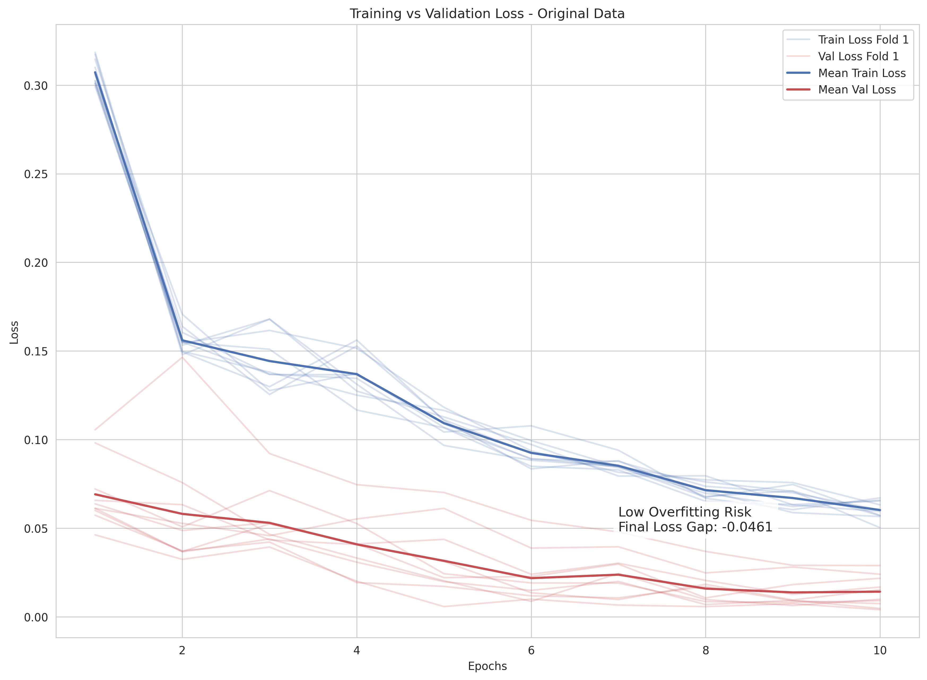
Overfitting Analysis
Training vs. validation loss curves analyzed to assess overfitting
Small final gap: 0.0461
Both losses decrease steadily across epochs
Indicates low overfitting risk and good
generalization

Slide 15
Effect of Freezing Weights in Transfer Learning
What Are Frozen Weights?
In transfer learning, frozen weights refer to layers in a neural network whose parameters are not updated during training.
This technique is used to preserve knowledge from a pre-trained model, while fine-tuning only specific parts of the network.
Why Freeze Weights?
Avoid overfitting when training on small datasets
Speed up training time
Leverage pre-learned features (e.g., edge detectors, object parts)

Slide 16
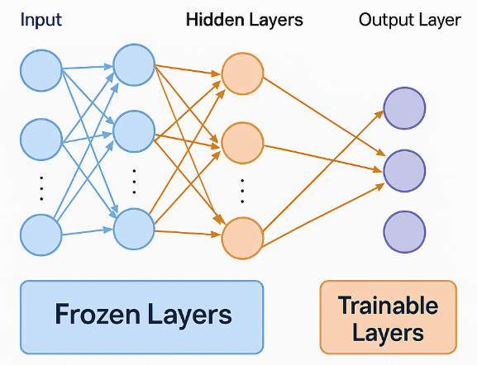
Effect of Freezing Weights in Transfer Learning

Slide 17
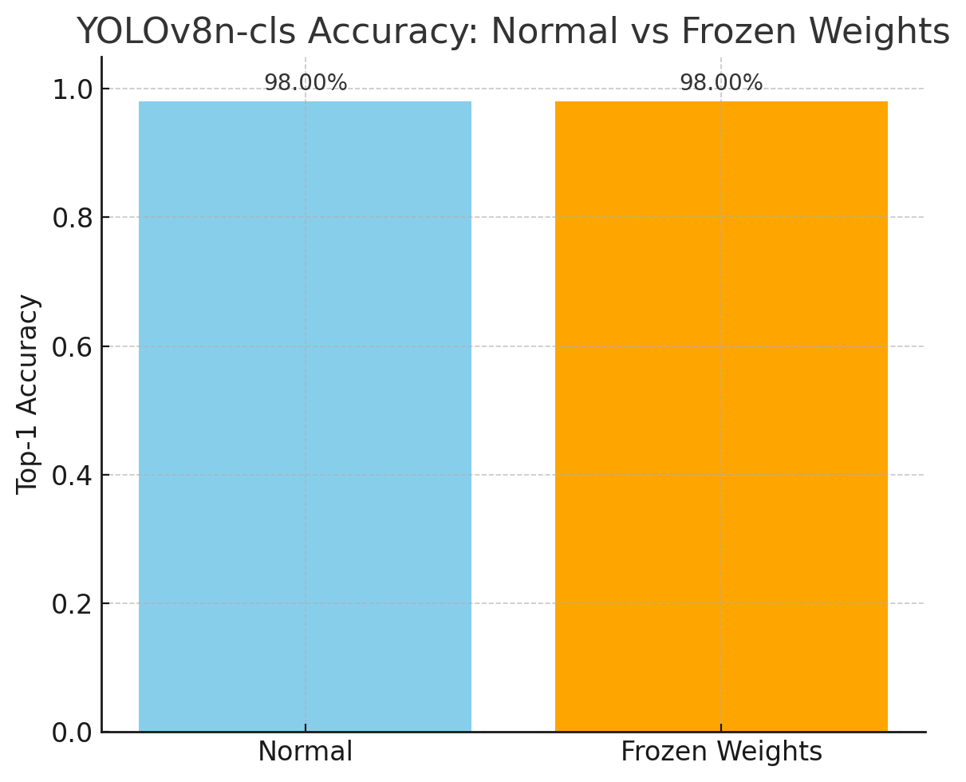
Experiment Results – Effect of Freezing Weights
To evaluate the effect of freezing early layers in a pretrained YOLOv8n-cls model, we compared two training configurations for a binary classification task (ship vs no-ship).
The similar accuracy suggests that freezing early layers did not negatively impact model performance.

Slide 18
ResNet50 for Image Classification

Slide 19
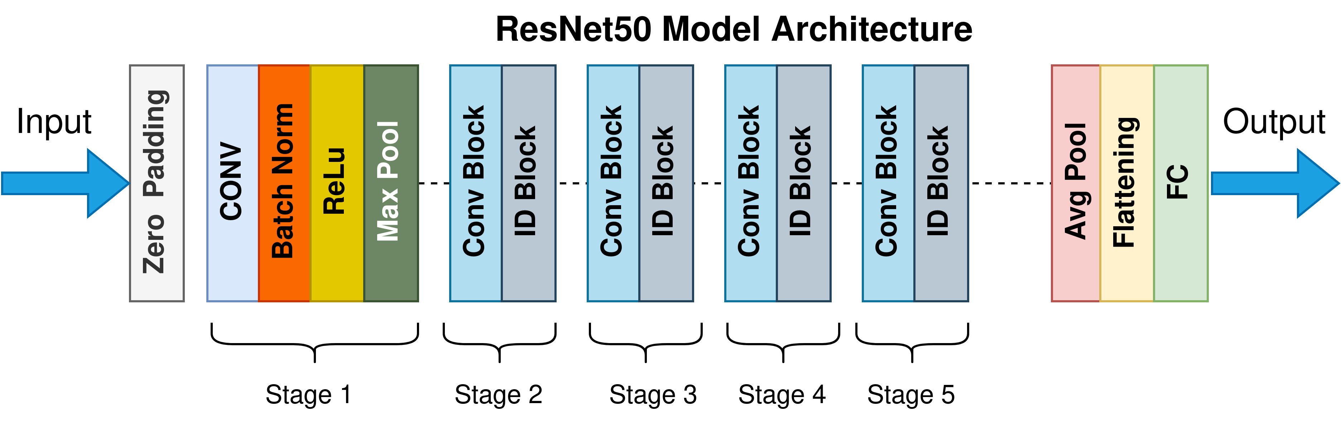
ResNet50 for Image Classification

Slide 20
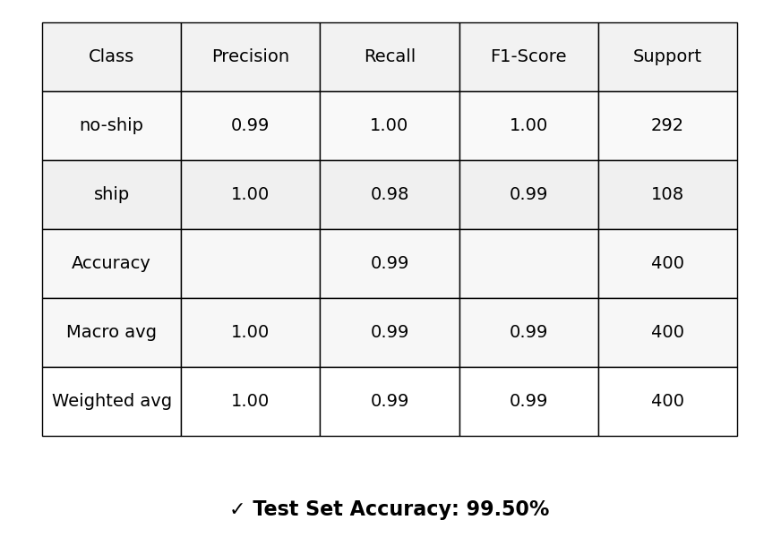
Classification Report – Test set -

Slide 21
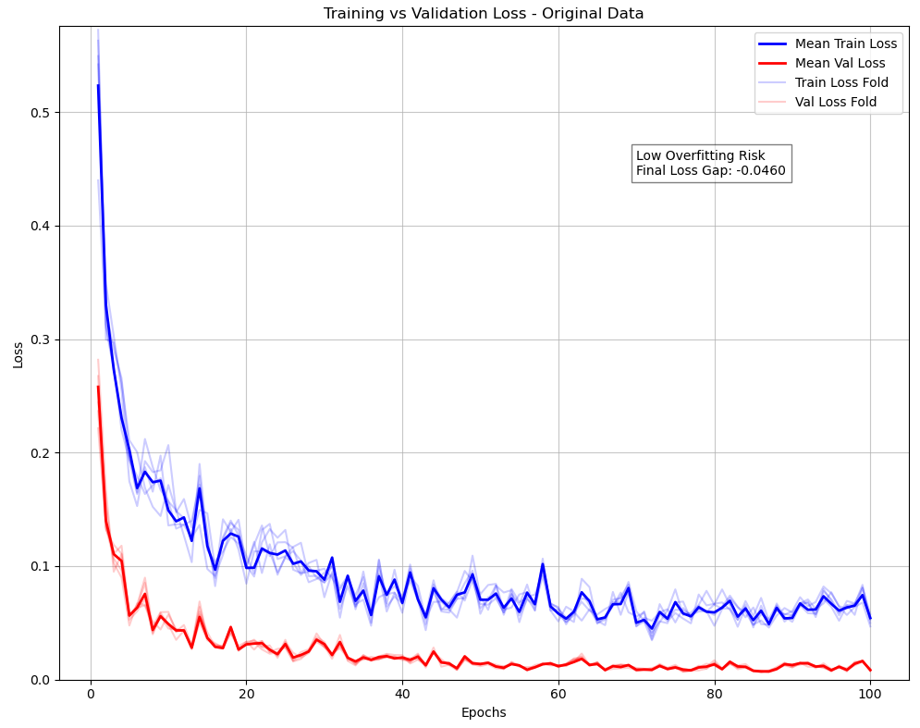
Overfitting Analysis
This graph shows the training vs. validation loss across 100 epochs.
Two key insights show low risk of overfitting:
The final loss gap between training and validation is very small: 0.046.
Both curves stabilize and converge early, indicating good generalization.
We also simulate 5 training folds (light lines), and all show consistent convergence, reinforcing that the model is stable and not overfitted.

Slide 22
Enhanced Satellite Resolution

Slide 23
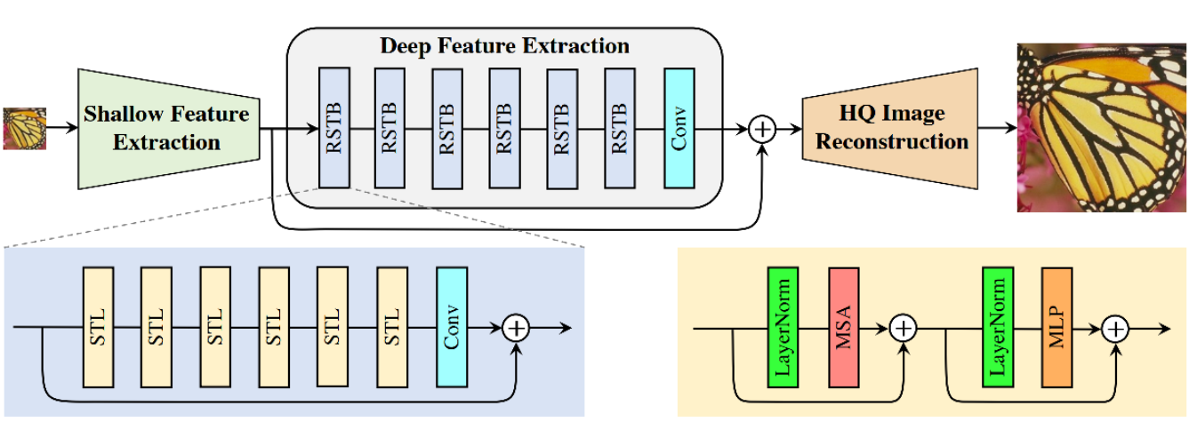
SwinIR (Swin Transformer for Image Restoration)

Slide 24
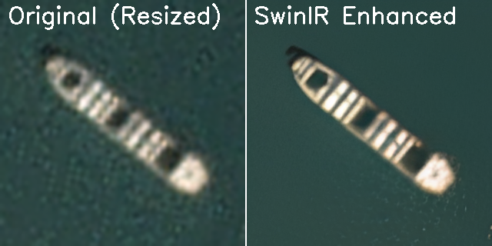
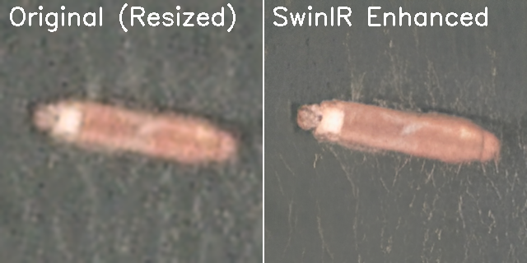
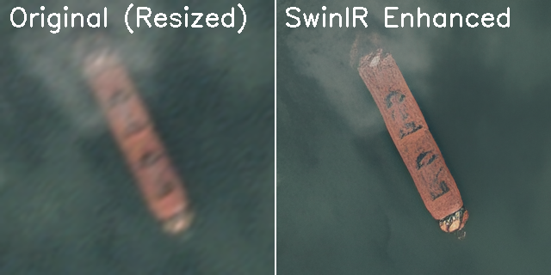
Enhanced Satellite Resolution

Slide 25
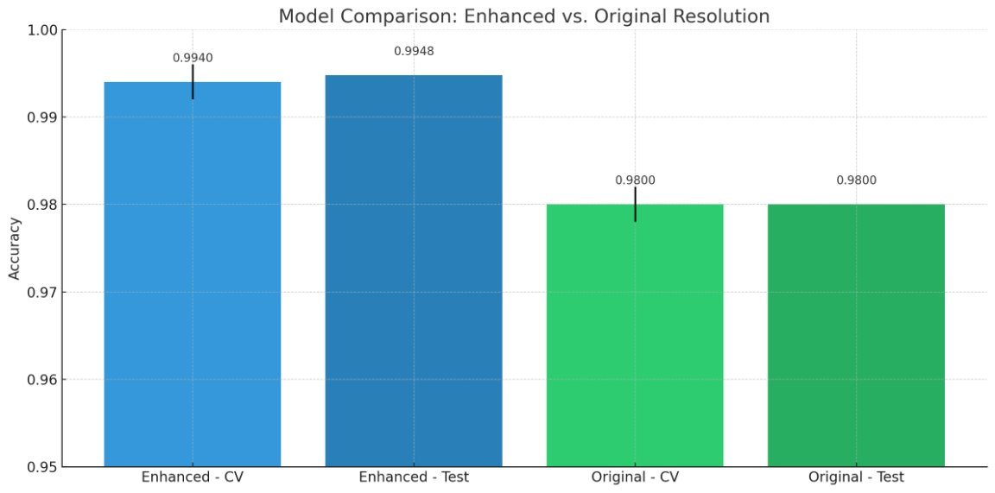
Enhanced Satellite Resolution Evaluation

Slide 26
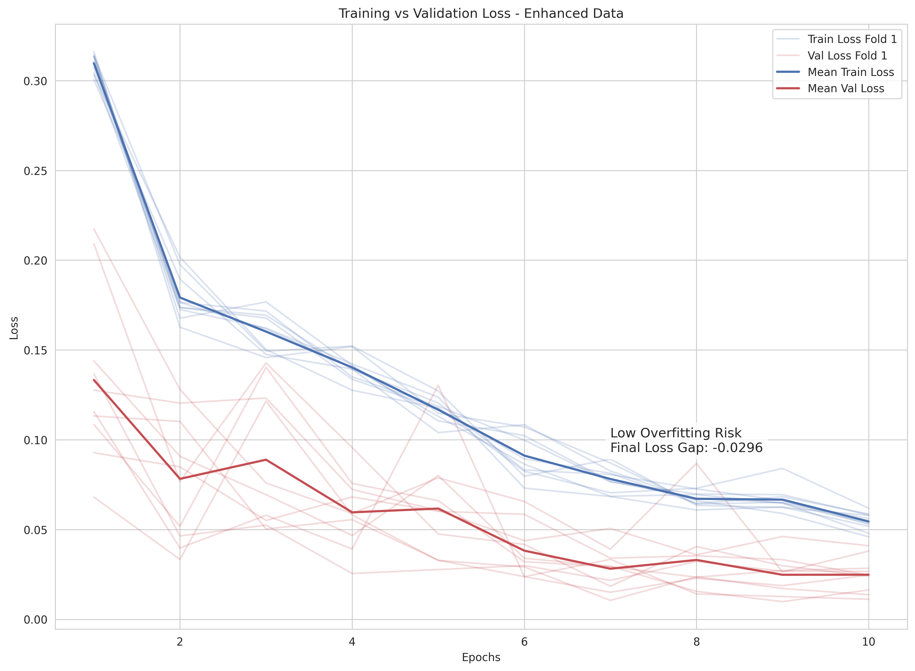
Overfitting Analysis
Overfitting is evaluated after applying resolution enhancement
Final loss gap: 0.0296 — smaller than with original data
Training and validation losses decrease
smoothly
Indicates even lower overfitting risk and
Improved learning stability

Slide 27
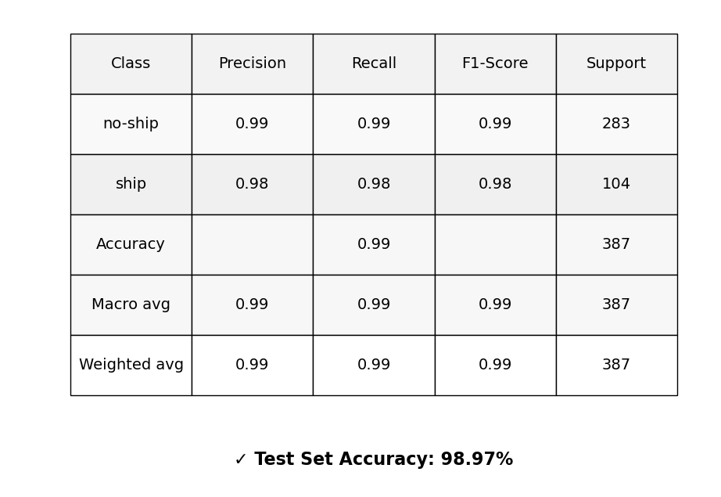
ResNet50–After Super-Resolution

Slide 28
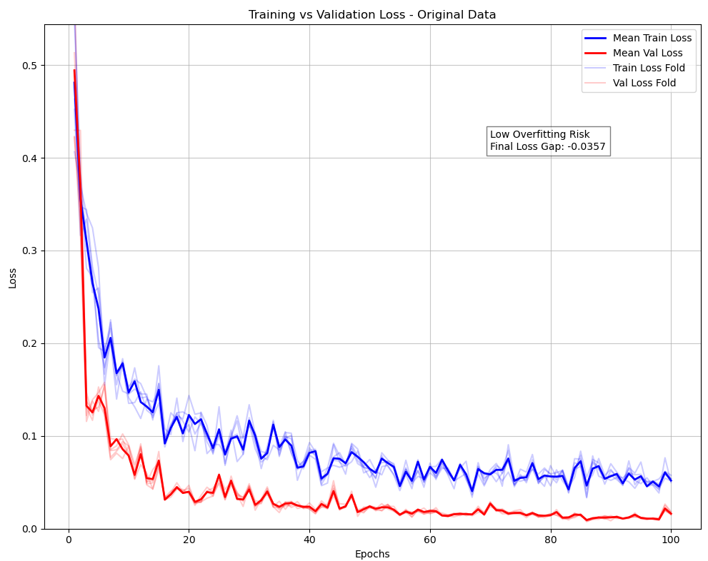
Overfitting Analysis ResNet50–After Super-Resolution
We analyzed overfitting risk after enhancing the input data with SwinIR.
Observations:
The gap between training and validation loss is very small: Final Loss Gap = -0.0357
Curves converge nicely and stabilize early, indicating low overfitting.
Simulated folds (light lines) again show consistent convergence.
Overall, the model remains well-generalized, even after introducing image super-resolution.

Slide 29
Future Work

Slide 30

Future Work
Deploy the model in real-time satellite systems
Expand dataset with more diverse images
Classify different ship types (not just ship/no-ship)
Add cloud/noise filtering before detection
Optimize for fast edge deployment

Slide 31
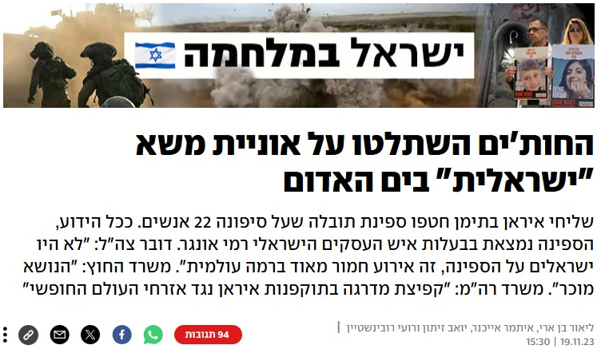
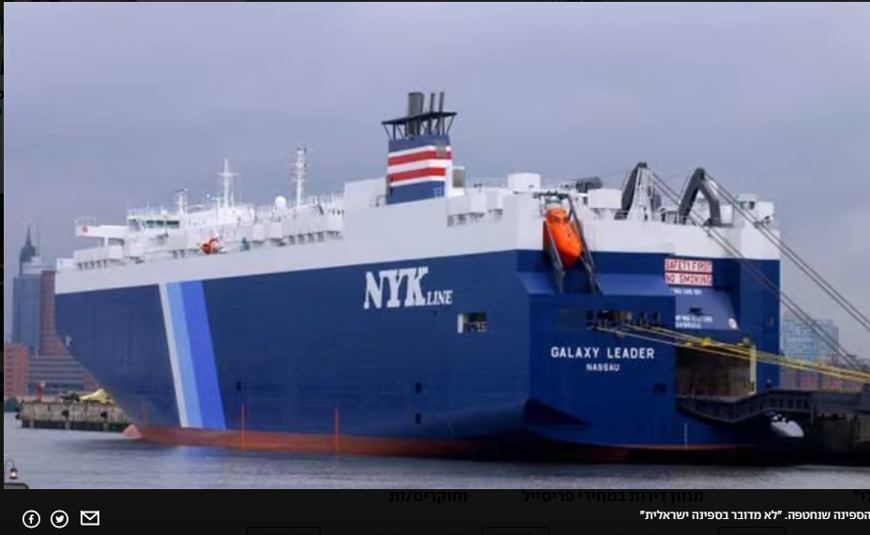
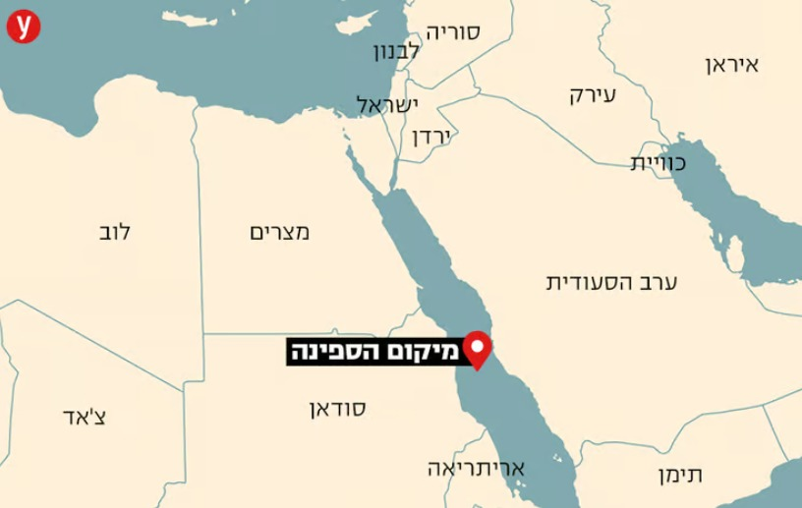

Slide 32


Slide 33



Slide 34
Questions

